Slide 1


PSBN
Perform Script [ By Name: …
…or FM↔️FM APIs
dotFMP, Berlin 2017
mrwatson-gbs

Slide 2

but…
😃
FM16
Integration
FM16 = Integration = APIs

Slide 3


What about an "FM↔️FM API"?
File A
File B

Slide 4

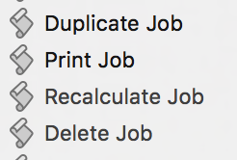
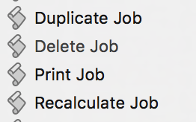
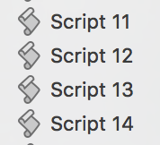


What about an "FM↔️FM API"?
1
File A
File B'
File B
Perform Script
Perform Script "Delete Job"
Perform Script #12
Perform Script "Print Job"
That is 'dangerously' hard-coded!

Slide 5
What about an "FM↔️FM API"?
2
Dispatch Script
:
Else If [$ScriptName = "Print Job"]
Perform Script [ "Print Job" ]
:
Else If [$ScriptName = "Delete Job"]
Perform Script [ "Delete Job" ]
:
Else If [$ScriptName = "Recalculate Job"]
Perform Script [ "Recalculate Job" ]
:
Else If [$ScriptName = "Print Job"]
Perform Script [ "Delete Job" ]
:
Else If [$ScriptName = "Delete Job"]
Perform Script [ <unknown> ]
:
Else If [$ScriptName = "Recalculate Job"]
Perform Script [ "Print Job" ]
File A
File B
still hard-coded!

Slide 6
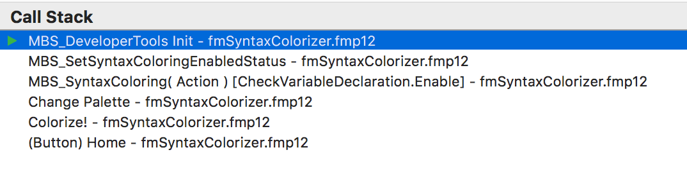


What about an "FM↔️FM API"?
3
File A
File B
"X"
Asynchronous
Perform Script "X"
By Name …
Context lost
NO ScriptResult!

Slide 7

What about an "FM↔️FM API"?
4
File A
File B
"X"
fmpurl "X"
Performed in
wrong FileMaker!

Slide 8
What about an "FM↔️FM API"?
5
File A
File B
via PHP / XML API -> via Server

Slide 9
What about an "FM↔️FM API"?
6
File A
File B
Discuss
Perform Script [ By Name: …
Doesn't exist

Slide 10
What about an "FM↔️FM API"?
7
File A
File B
Perform Script [ "By Name": …
prototype
😃
A module from mrwatson-gbs

Slide 11
DEMO
prototype
😃
A module from mrwatson-gbs

Slide 12
NEXT STEPS
✅ Go vote for PSBN on the FileMaker community web site:
idea 1187: Perform Script [ by Name: ... ] - immediately + natively

Slide 13
Thank you

